Slide 1
UltraLite Coding: Banqi
Nicholas Walter
Tyler Hogenson
Spencer Lofing
Ben Finnerty
Max Maier

Slide 2
Package Diagram

Slide 3
Updated Design Class Diagram

Slide 4
Refactoring and Design pattern list

Slide 5
Traceability Link Matrix

Slide 6
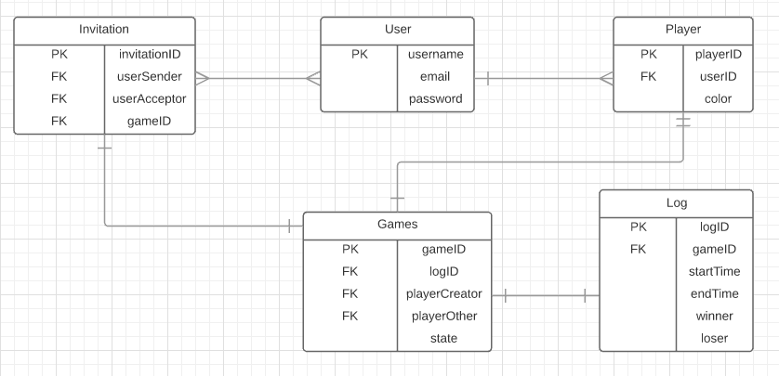
Entity Relationship diagram

